Slide 1
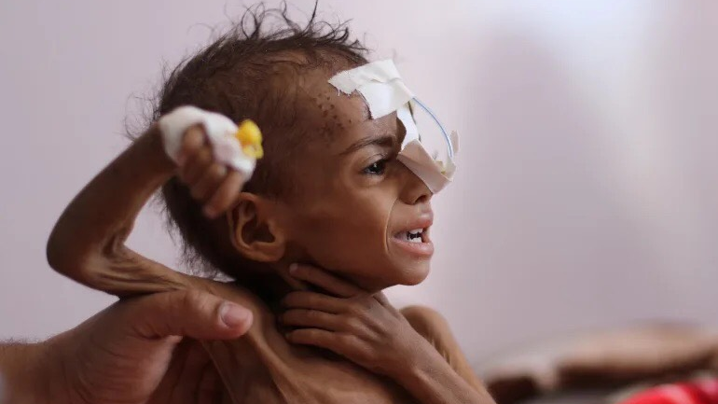
Why Health Care Of Yemen In Decreasing?
10.oct.2022
Yemen Hunger
Done by : Eman Alsoufi

Slide 2
HUNGER
Hunger is a distress caused by a lack of food. Food deprivation, or undernourishment, is defined as consuming fewer than 1,800 calories per day. Undernutrition extends beyond calorie deficiency to decrease energy, protein, and/or essential vitamins and minerals deficiencies. Malnutrition encompasses both undernutrition and overnutrition (problems with unbalanced diets). Food security refers to the availability, accessibility, and utilization of food. A person is considered food secure if they always have adequate availability and access to enough safe and nutritious food to live an active and healthy life.

Slide 3
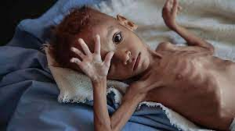
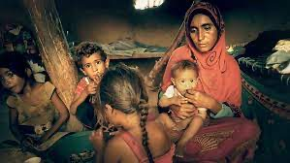
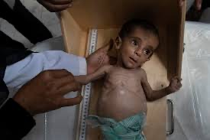
Hunger In Yemen
12.oct.2022
Yemen already dire hunger crisis is teetering on disaster, with 17.4 million people now in need of food assistance . The growing portion of the population dealing with emergency levels of hunger.According to the latest food insecurity analysis, there is a rise in acute malnutrition among children under five years ,new mothers ,pregnant or nursing mothers are also at risk from the dire lack of food.
After seven years of fighting, “many households in Yemen are deprived of basic food needs”, said,Director-General of the Food and Agriculture Organization (FAO). Highlighting the long-lasting, negative impact on children, UNICEF Executive Director Catherine “The plight of children in Yemen can no longer be overlooked”

Slide 4
Causes : Effects:
- Malnutrition -Death
-Natural disaster - Weakness
-Poverty - pain
-War - weight loss
- Lack of infrastructure

Slide 5
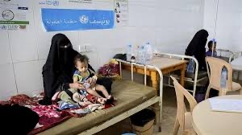
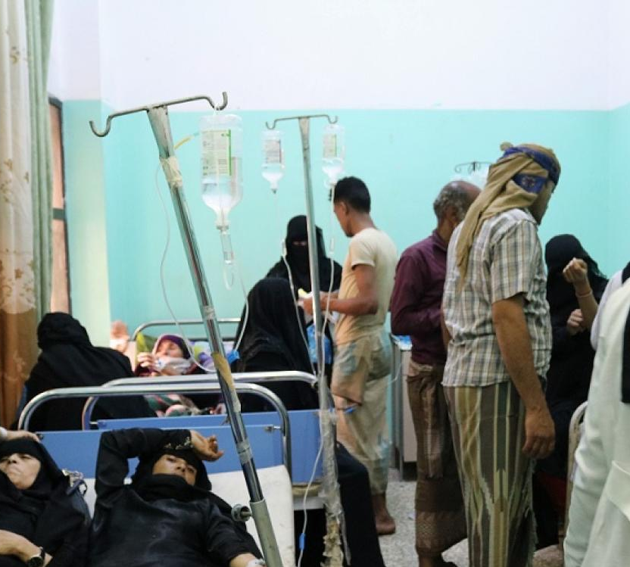
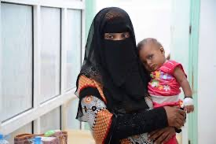
Health system In Yemen
12.oct.2022
Yemen is experiencing the worst humanitarian crisis the world has ever seen, which is made by a worse persistent hostilities. Through initiatives that boost social cohesion, enhance access and control of the water sector there is a restoring of the country's fundamental health and education institutions. Also it stabilize the economy.
Yemen bridges the gap between relief and development. It was unable to receive basic healthcare services. Only 51% of Yemen's healthcare institutions are completely operational, and the majority lack essential supplies such operational personnel, equipment, and basic medications. Services for the most disadvantaged are impacted by these inequalities, particularly for women and children.

Slide 6
Why Health Care Of Yemen In Decreasing?
Because they cannot afford transportation or their own expenses while their children are receiving assistance, parents are frequently unable to bring their children to treatment facilities .Yemen's already dire hunger crisis is teetering on disaster, with 17. 4 million people now in need of food assistance and the growing portion of the population dealing with emergency levels of hunger. According to UN agencies 2 million of children are now acutely malnourished across the country, which was already one of the poorest in the world before the conflict erupted; an additional 500,000 children face severe acute malnutrition, which is a life-threatening condition.
Hajjah, Hodeida, and Taizz are among the worst-affected govern-orates. According to a new Integrated Phase Classification (IPC) analysis on Yemen released on Monday, pregnant or nursing mothers are also at risk from a severe lack of food, with approximately 1.
3 million acutely malnourished. "The clear takeaway (from the IPC findings) is that we must act immediately," said Mr. Gressly, UN Resident and Humanitarian Coordinator for Yemen. "We must continue to provide comprehensive humanitarian assistance to millions of people, including food and nutrition assistance, safe drinking water, basic health care, shelter and other essentials.
These staggering numbers confirm that we are counting down to disaster in Yemen, with little time left to avert it," said a World Food Program (WFP) official. occurred in Ahead of a high-level fundraising event on Yemen's humanitarian crisis this Wednesday, Yemen's senior UN relief official, David Gresley, tweeted, "Maintaining food and nutrition, clean water, basic health care and shelter
According to the latest food insecurity analysis, there's been a rise in acute malnutrition among children under five years in Yemen, and new mothers. 3 million acutely malnourished, according to the new Integrated Phase Classification (IPC) analysis on Yemen, released on Monday. Hossam El-Sharqawi, made field visits to Sanaa, Aden, Amran and Raj this week to discuss the many cases of children suffering from severe acute malnutrition. "I am deeply saddened by the devastating levels of hunger and severe malnutrition that are affecting babies, children and women in Yemen," he said.
7 million people in need in Yemen already has huge gaps in clean water, healthcare, food and nutrition. Elsharkawi met with YRCS leaders and volunteers and Yemeni government officials in Sana'a, Aden and Raj to discuss humanitarian gaps and his IFRC-supported programs.

Slide 7
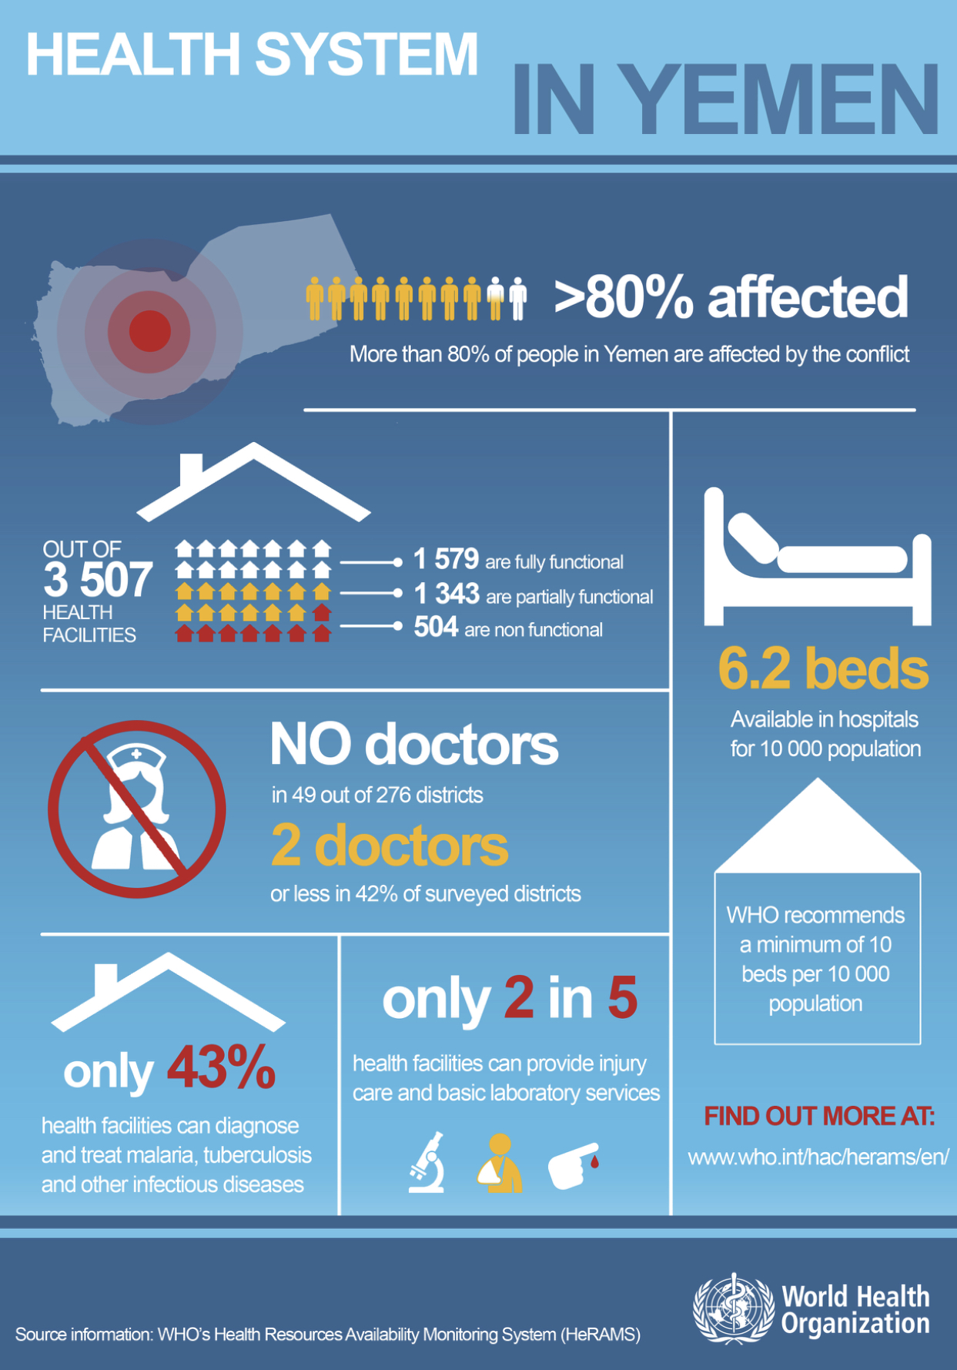
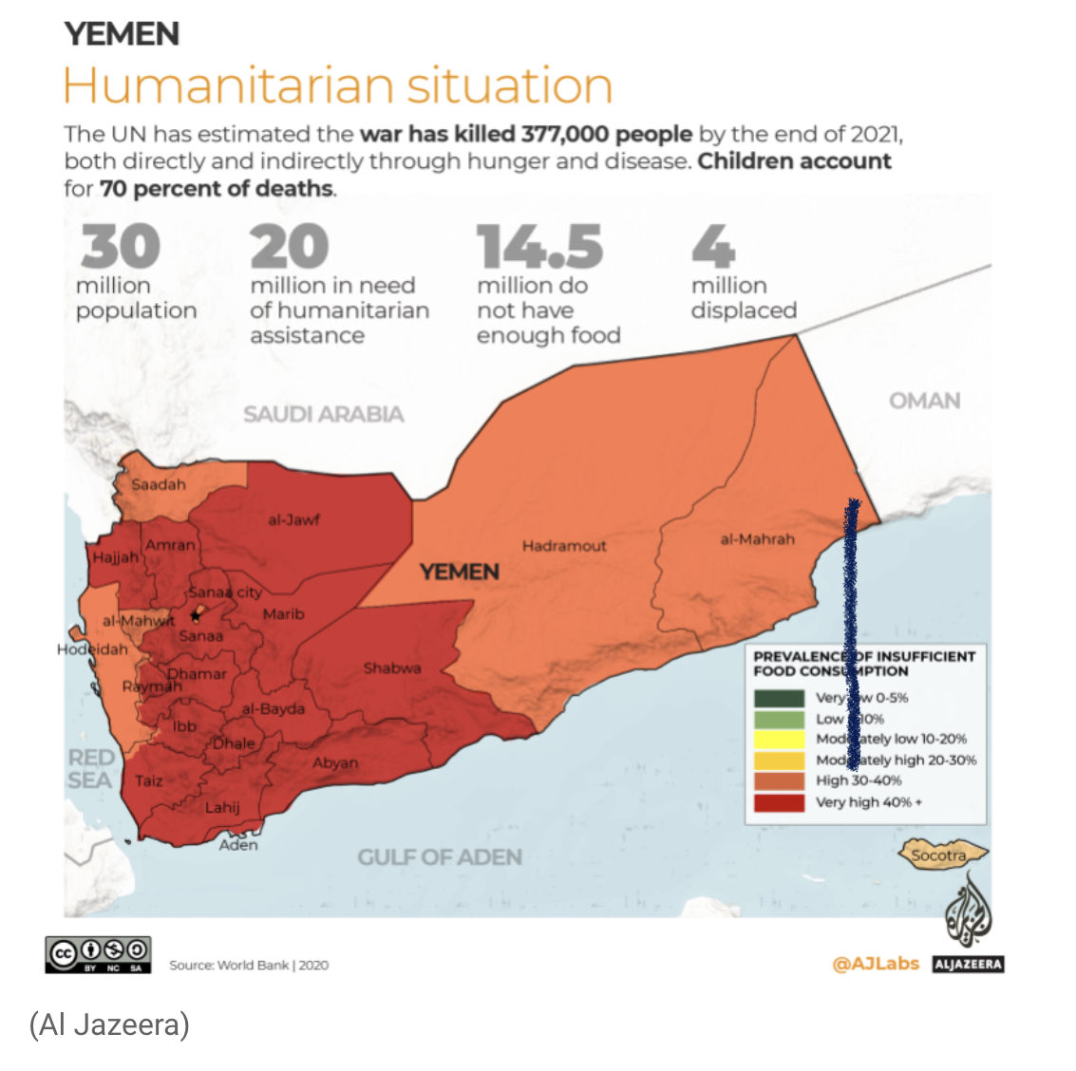

Slide 8
Solutions
Eman Alsoufi
Stop the war
Stop the political problems, people and the government must stand and work with each other to solve many problems
Open the airports so people can escape or just can go for work outside the country to save their children and families from this famine
Open more hospital so we can save many people
Reduce prices so it can be suitable for all people
The existence of job opportunities

Slide 9


